Slide 1
Determining and Modeling Hazardous Near Earth Objects
By: Dwayne Bost and Jared Klein
Notes:
Dwayne intro

Slide 2
What Are Near Earth Objects?
According to NASA, a NEO (Near Earth Object) is “are comets and asteroids that have been nudged by the gravitational attraction of nearby planets into orbits that allow them to enter the Earth’s neighborhood.”
Put simply, they are objects in our solar system that are “near” Earth.
These NEOs become hazardous and a potential danger to Earth when they come within Earth’s MOID (Minimum Orbit Insertion Distance).
NASA specifies that “all asteroids with an Earth Minimum Orbit Intersection Distance (MOID) of 0.05 au or less and an absolute magnitude (H) of 22.0 or less are considered PHAs.”
Source: https://cneos.jpl.nasa.gov/about/basics.html
Notes:
Dwayne

Slide 3
Who Really Cares? What is the Value of this study?
Governments, scientists, and students alike all value data on NEO’s for various reasons. The latter two audiences like to talk about finding answers about the behavior of celestial objects and the origins of the cosmos. However, the former audience, governments, have interests that more align with the defense of the planet.
It is true that the likelihood of Earth being hit by a NEO which could harm our planet is incredibly low (NASA’s Planetary Defense Coordination Office claims that it is less that 0.2 percent ). Nevertheless, governments around the world still worry about the threat of NEOs.
Why?
Notes:
Jared

Slide 4
Here’s Why…
Verdefort Crater, South Africa
Sudbury Basin, Ontario, Canada
These physical features on Earth’s surface are believed to have been caused by NEOs colliding with the Earth’s surface. Some of these collisions are theorized to have changed life on Earth as we know it. Remember the Dinosaur theory?
Illustration of Chicxulub impact crater in the Yucatán Peninsula
Source: https://news.nationalgeographic.com/news/2013/13/130214-biggest-asteroid-impacts-meteorites-space-2012da14/
Notes:
Jared

Slide 5
Questions We Asked And the Data We Needed
Questions we asked:
What data is used to classify a NEO as hazardous?
How do we model and visualize hazardous NEOs?
How can we anticipate and determine NEO hazards?
How likely is Earth to be hit by a potentially planet altering NEOs?
Our Goals with this project:
Examine the characteristics of the asteroid related to its classification as hazardous.
Model the orbital movements of NEOs closest to and relative to the Earth.
Examine the probability of Earth being hit by a devastating NEOs.
The data we used:
NASA’s NeoWs open API which provided information on thousands of Asteroids.
Included data such as: the asteroid name, its relative velocity of the asteroid, it’s close approach date to Earth, and it’s absolute magnitude.
We also included data from NASA’s Fireball csv files that included data on locations of impacts.
Notes:
Dwayne do “questions we asked” , Jay do the rest

Slide 6
Motivation & Summary of Findings
Motivation for taking on this project stems from a desire to improve our elementary knowledge of Asteroids, and assess what makes a NEO hazardous.
Summary of our findings:
The relationship between a NEO’s specific absolute magnitude (H) of the object and its proximity to Earth assists scientists in the classification of hazardous NEOs.
Scientists use orbital data (eccentricity, inclination, etc.) to predict the orbits of NEOs which can then be used to model their distance from Earth. Essentially, scientists can use predictors and models to anticipate near earth hazards.
The actually probability of a NEO devastating Earth is incredibly small. That said, predictive data courtesy of NASA’s SENTRY dataset suggest that certain individual NEOs have hundreds of opportunities to impact Earth.
Notes:
Jared
the magnitude (brightness) of a celestial object as it would be seen at a standard distance of 10 parsecs (1 AU). This is hypothetical scenario because NEOs aren’t typically seen at a zero phase angle.
Eccentricity refers to how elliptical the orbit of an object is.
Inclination refers to the objects angle between its orbital plane and the elliptical plane.
H is the absolute magnitude of the minor planet. This is the magnitude that it would have if it was 1 AU from the Earth and 1 AU from the Sun while having a phase angle of 0 degrees. This is an impossible scenario but it is just the definition of H. This is different than the absolute magnitude used for stars.

Slide 7
Data Cleanup & Exploration
Methods and Insights we did not anticipate:
Methods:
Cleaned and saved data into csv’s using jupyter notebook.
Used modules such as: pandas, matplotlib, astropy, and poliastro. The latter two were for orbital visualization.
Surprising Insights:
Terminology to determine what is a hazardous object, and the sheer number of hazardous objects that routinely pass by Earth.
According to Kepler’s secondary law of planetary motion, “the speed of an object in its orbit is fastest at perihelion and slowest at aphelion.” Perihelion being the closest point of an object orbiting the sun, and aphelion being the opposite. This applies to asteroids as well, and their relative velocities.
Problems:
We had difficulty indexing the NASA JSON. We had to run several ”for” loops in order to retrieve the information we needed.
Given the volume of the NASA API (i.e.. NEO having multiple approach dates), parsing the JSON request was difficult.
Needed to use multiple different url’s to query different NEO information (i.e.. NEOs info organized by dates as opposed to the whole database).
Had difficulty propagating EPOCHS, or specific points in time, for individual asteroids to create a reliable orbit visualization.
Our elementary understanding of NEO’s and the science meant that we had to do significant research in order to determine what data we needed. (i.e.. MOID, EPOCH, Perihelion Distance, Perihelion Argument etc.
Source: https://www.windows2universe.org/physical_science/physics/mechanics/orbit/perihelion_aphelion.html&edu=high
Notes:
Jay talk about the methods we used, Dwayne talk about problems

Slide 8

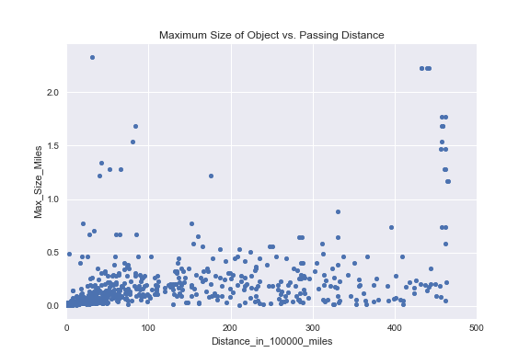
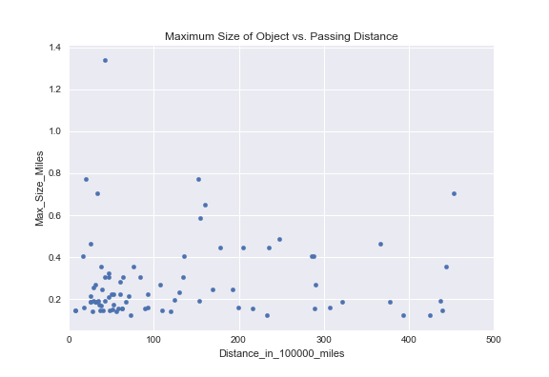
Data Analysis: There are A ton of Asteroids
This is just a small subset of 500 NEOs for representation purposes reflecting size vs. passing distance. Shown to visualize just how many objects there are to study.
Hazardous NeOs
Now that we have the given data size of NEOs, we now need to ask how many of those are hazardous?
That’s what this visualization is for. We’ve essentially filtered the previous graph for just those that are determined to be hazardous.
By doing this exercise, we’ve now been able to visualize our dataset, and we’ve filtered for our NEOs in question.
Notes:
All Dwayne

Slide 9
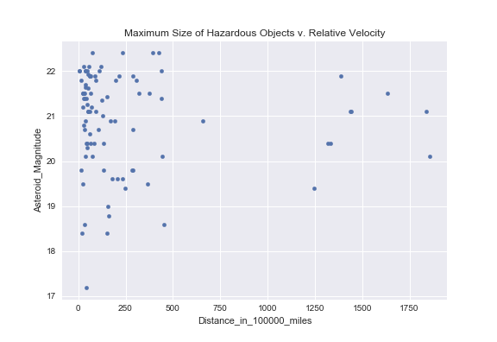
Data Analysis: Determining which Neos are Hazardous.
This scatter plot is a visualization of the definition of a hazardous NEO.
Recall the earlier slides, where a hazardous NEO is classified by the relationship between its absolute magnitude(H) and its MOID (distance from Earth < .05 astronomical units or around 4.6 million miles).
For context, magnitude is used to estimate the diameter of the Asteroid which helps determine its size. Thus, assists in its classification as hazardous (equation below).
This establishes that there is a relationship between the size and distance from of a NEO from Earth which leads to its classification.
Notes:
Again Dwayne
H is the absolute magnitude of the minor planet. This is the magnitude that it would have if it was 1 AU from the Earth and 1 AU from the Sun while having a phase angle of 0 degrees. This is an impossible scenario but it is just the definition of H. This is different than the absolute magnitude used for stars.

Slide 10
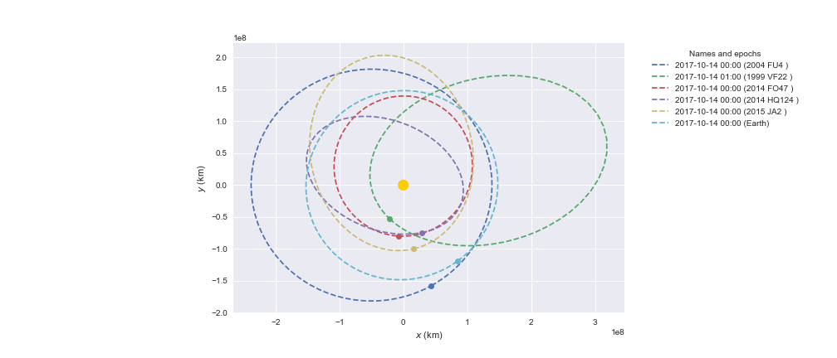
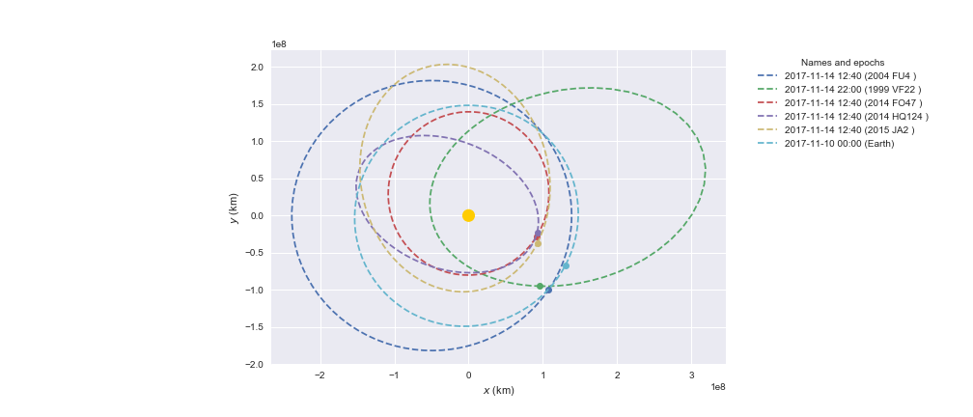
Data Analysis: Modeling NEO orbits and their proximity to Earth
Here is have another method of visualizing how NEOs come to be classified as hazardous.
The following two images display the orbital paths of the five asteroids chosen by their nearest approach date to Earth (presently, the closest NEOs to Earth) and their classification as hazardous. The light blue ellipse is the orbital path of Earth while the yellow dot is the sun.
The left image shows where the NEOs were about a month ago. The right image shows where the NEOs are at this point in time. All five are now at their closest point to Earth.
Thus far, we have shown a small subset of NEOs involved in our study, how many of those are classified as hazardous, what attributes call for a hazardous classification, and how the a NEOs orbit progresses to the point where it can be considered hazardous.
Notes:
Jay here

Slide 11
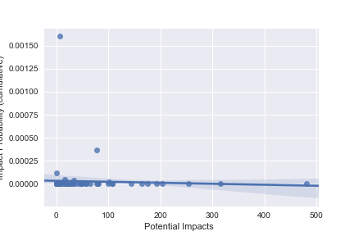
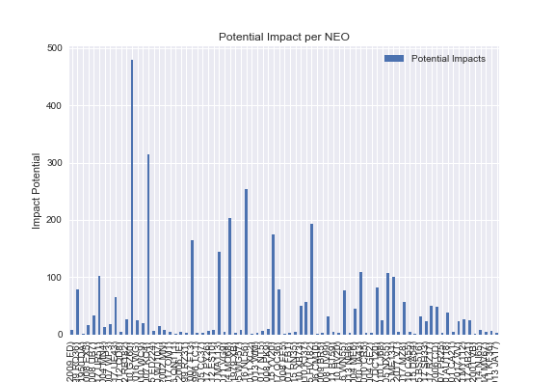
DATA Analysis: How likely are we to get hit by a NEOS?
As of the November 10th, 2017 update of NASA’s SENTRY dataset, the likelihood of Earth being hit by a devastating NEOs is incredibly minuscule.
The graph to the top left explains this. Each dot represents a specific NEO and the number of potential impacts it could have with Earth relative to the probability that they will actually hit the Earth cumulatively. As you can see, most NEOs have fewer than 100 potential impacts with extremely little probabilities of contacting Earth.
To the bottom right, we categorized the potential impacts relative to each specific NEOs.
Notes:
Jared Starts, Dwayne finishes with last bullet

Slide 12
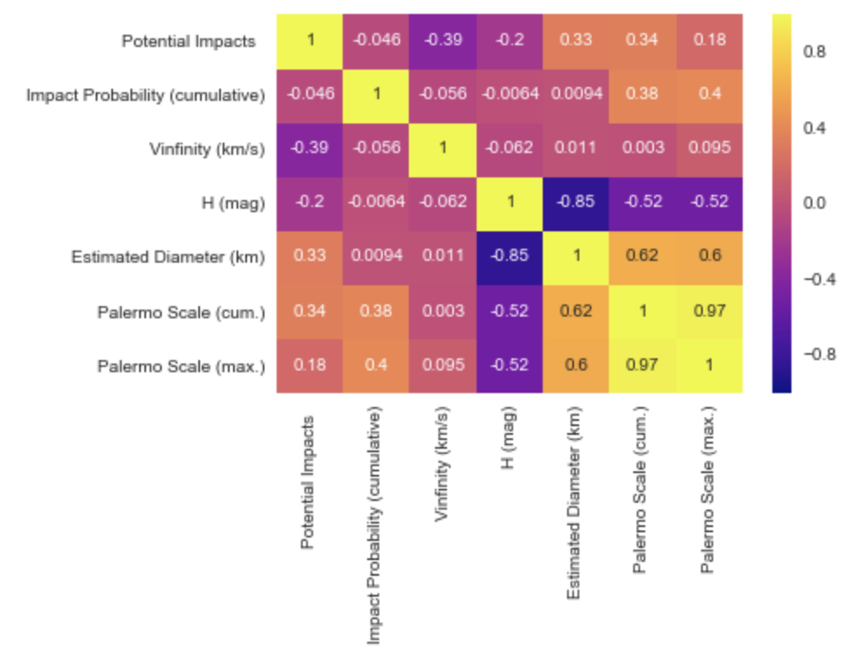
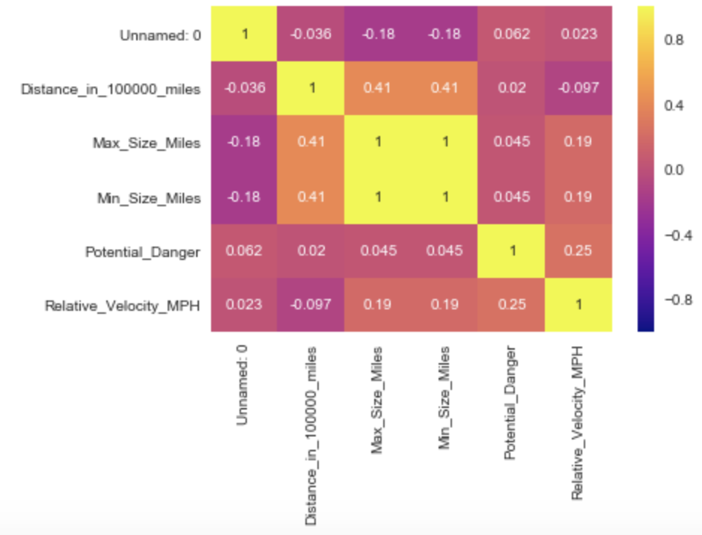
Post Mortem
Throughout the project, we collected a wealth of data on NEOs such as their orbit statistics (eccentricity, perihelion distance, orbital period, etc.), their characteristics (size, velocity), and data on prior NEOs collisions on Earth thanks to NASA’s FIREBALL and SENTRY datasets.
With all this available data the possibilities for finding new relationships and discoveries are broad.
That is why we have the images to the left. Both these heat maps can be used to identify possible relationships. For example, in the future we could visualize the potential danger of a NEOs with its relative_velocity. The same could be done with a NEOs estimated diameter and its placing on the Palermo Scale (scale used by NASA to categorize impact risks).
Notes:
H is the absolute magnitude of the minor planet. This is the magnitude that it would have if it was 1 AU from the Earth and 1 AU from the Sun while having a phase angle of 0 degrees. This is an impossible scenario but it is just the definition of H. This is different than the absolute magnitude used for stars.
Jay could do this one.

Slide 13
Questions?

